Slide 1
Using the Continuum of Access
for Academic Research
Presented by CRDCN
Recorded X Xth, 2022.
https://youtu.be/vBJDPkdrqq8

Slide 2
Continuum of access
Public-use Microdata Files (PUMF)
Real-time Remote Access (RTRA)
Research Data Centre (RDC) masterfiles – At Canadian Universities
Notes:
Rundown, then - If you haven’t yet got the very basics of the Continuum of Access, check out the link to the Data Access Divisions Microdata Access page below this video.

Slide 3
Can I replicate a paper?
Replicate an analysis from inside the RDC, how far can I go with each source?
In the paper, we have:
Population averages for the sample
Unadjusted odds ratio
Adjusted odds ratio
Mehra, V. M., Costanian, C., Khanna, S., & Tamim, H. (2019). Dental care use by immigrant Canadians in Ontario: a cross-sectional analysis of the 2014 Canadian Community Health Survey (CCHS). BMC oral health, 19(1), 1-9.
Notes:
Rundown, then - If you haven’t yet got the very basics of the Continuum of Access, check out the link to the Data Access Divisions Microdata Access page below this video.

Slide 4
So what can be recreated?
Section of Paper | Example | RDC DATA | RTRA DATA | PUMF DATA
Summary Statistics | What proportion of the sample is female? | Yes | Yes | Not as in the paper, but quite similar
Unadjusted Odds-ratios | How many men have poor dental care relative to women | Yes | Technically yes, but very awkward, bad estimate of the confidence interval | Not as in the paper, but quite similar
Adjusted Odds-ratios | How many men have poor dental care relative to women conditional on income, marital status etc. | Yes | No regressions inside of RTRA | Not as in the paper, but quite similar

Slide 5
So what can be recreated?
Section of Paper | Example | RDC DATA | RTRA DATA | PUMF DATA
Summary Statistics | What proportion of the sample is female? | Yes | Yes | Not as in the paper, but quite similar
Unadjusted Odds-ratios | How many men have poor dental care relative to women | Yes | Technically yes, but very awkward, bad estimate of the confidence interval | Not as in the paper, but quite similar
Adjusted Odds-ratios | How many men have poor dental care relative to women conditional on income, marital status etc. | Yes | No regressions inside of RTRA | Not as in the paper, but quite similar

Slide 6
So what can be recreated?
Section of Paper | Example | RDC DATA | RTRA DATA | PUMF DATA
Summary Statistics | What proportion of the sample is female? | Yes | Yes | Not as in the paper, but quite similar
Unadjusted Odds-ratios | How many men have poor dental care relative to women | Yes | Technically yes, but very awkward, bad estimate of the confidence interval | Not as in the paper, but quite similar
Adjusted Odds-ratios | How many men have poor dental care relative to women conditional on income, marital status etc. | Yes | No regressions inside of RTRA | Not as in the paper, but quite similar

Slide 7
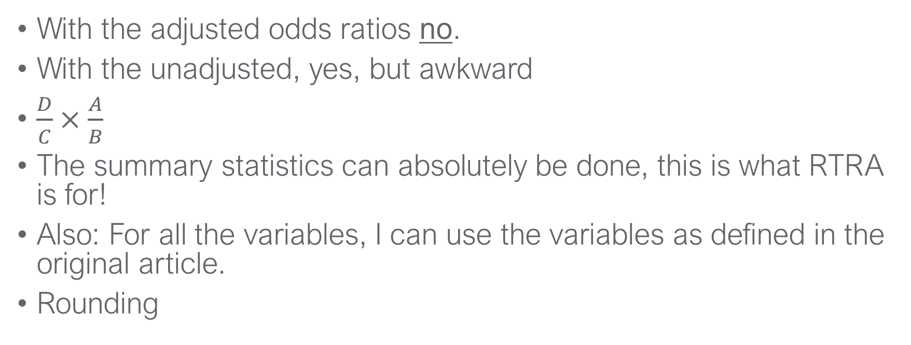
RTRA
With the adjusted odds ratios no.
With the unadjusted, yes, but awkward and standard errors wrong
$$\frac{D}{C}×\frac{A}{B}$$
The summary statistics can absolutely be done, this is what RTRA is for!
Also: For all the variables, I can use the variables as defined in the original article.
Rounding and weights
Notes:
These are just a composite of probabilities so I can compute them, BUT if d and b are the respective numbers of being in the "bad care" state for each group (and a and c the good care state). The problem is that I have to do all these calculations by hand which means that I’m spending more time computing these probabilities, and I’m more likely to make an error because there are so many hand-done calculations.

Slide 8
So what can be recreated?
Section of Paper | Example | RDC DATA | RTRA DATA | PUMF DATA
Summary Statistics | What proportion of the sample is female? | Yes | Yes | Not as in the paper, but quite similar
Unadjusted Odds-ratios | How many men have poor dental care relative to women | Yes | Technically yes, but very awkward, bad estimate of the confidence interval | Not as in the paper, but quite similar
Adjusted Odds-ratios | How many men have poor dental care relative to women conditional on income, marital status etc. | Yes | No regressions inside of RTRA | Not as in the paper, but quite similar

Slide 9
PUMF Variables vs. Masterfile
Variable | Original Article Definition | PUMF closest match
Household income ($) | <30,000; 30-99,999; 100,000+ | <20,000; 20,000-79,999; 80,000+
Years since immigration | <10 years; 10-20 years; >20 years | <10 years; 10+ years
Age in years | <18; 18-34; 35-54; 55+ | Can do, but only a coincidence
Notes:
Very convenient that in this paper that all variables are dichotomized. Continuous variables would stop working pretty quickly.
Ex. Income, age, years since immigration, exact income value

Slide 10
Comparing results – Dental visits outcome
Statistic ( sample proportion) |  | Original paper (RDC) | RTRA statistic | PUMF statistic
Immigration | Years since immigration <10 | 22.1% | 22.1% | 21.9%
 | Years since immigration 10-20 | 24.2% | 24.2% | 78.1%
 | Years since immigration 20+ | 53.8% | 53.8%
Sex - Male |  | 49.1% | 49.3% | 49.3%
*Original paper does not provide confidence intervals for proportions

Slide 11
Comparing results – Dental visits outcome
Statistic (unadjusted odds ratio) |  | Original paper (RDC) | RTRA statistic | PUMF statistic
Immigration | Years since immigration <10 | 1.90 (1.40-2.57) | 1.89 (1.61-2.23) | 1.84 (1.35-2.52)
 | Years since immigration 10-20 | 1.12 (0.84-1.50) | 1.12 (0.95-1.32) | 1
 | Years since immigration 20+ | 1.0 | 1.0
Sex - Male |  | 1.40 (1.10-1.79) | 1.41 (1.23-1.61) | 1.40 (1.09-1.82)
*RTRA CI are not accurate, estimates based on total _N from CCHS

Slide 12
Comparing results – Dental visits outcome
Statistic (adjusted odds ratio) |  | Original paper (RDC) | RTRA statistic | PUMF statistic
Immigration | Years since immigration <10 | 1.51 (0.94-2.41) | NA | 1.73 (1.16-2.58)
 | Years since immigration 10-20 | 1.23 (0.83-1.84) | NA | 1
 | Years since immigration 20+ | 1.0 | NA
Sex - Male |  | 1.84 (1.35-2.51) | NA | 1.79 (1.34-2.40)
-Dental insurance control not in this model
-Income controls had to be redefined

Slide 13
Using the continuum for academic research
RTRA isn’t really useable for typical data-analysis research paper
Without capacity for regression, the analysis generally won’t be of sufficient depth/quality for publication
Could be useful for framing qualitative work
PUMFs can and have been used for data-analysis research paper
This paper might have been published if they had analyzed the PUMF
The quality of the analysis is better with the RDC and lots of topics can’t be studied with Public-Use data
Notes:
SPEAK TO in 17

Slide 14
Using the continuum for academic research
RTRA isn’t really useable for typical data-driven research paper
Without capacity for regression, the analysis generally won’t be of sufficient depth/quality for publication
RTRA can be very useful in other situations
Contextual background for qualitative empirical work
Understanding whether you have something before starting a data-driven paper
Cases where there’s no availability of public use files (especially as admin data start becoming more available)
Notes:
SPEAK TO in 17

Slide 15
Using the continuum for academic research
Sample paper probably would have been publishable without going into the RDC
Minimal loss of resolution in variables
All variables needed are available
Variables are binned even when continuous
But this isn’t normally the case
Not possible to investigate the same outcomes for off-reserve indigenous population, for example.
Different statistical procedures likely off the table
E.g. Income gradient

Slide 16
Get started
Speak with your university librarian or data librarian
Visit the CRDCN website
Visit the StatCan website

